Slide 1
The tiling algorithm
“Learning in feedforward layered networks: the tiling algorithm”
writed by Marc Mézard and Jean-Pierre Nadal

Slide 2
Outline
Introduction
The tiling algorithm
Simulations
Concluding remarks

Slide 3
Introduction
The feedforward layered system
The drawbacks of back propagation
  The structure of the network has to be guessed.
  The error is not guaranteed to converge to an absolute minimum with zero error.
Units are added like tiles whenever they are needed.

Slide 4
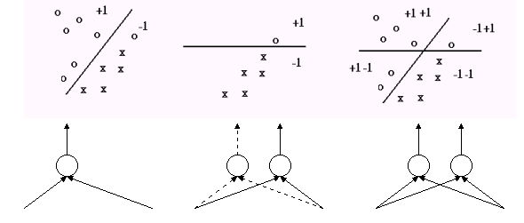
Introduction

Slide 5
The tiling algorithm
Basic notions and notation
Theorem for convergence
Generation the master unit
Building the ancillary units: divide and conquer

Slide 6
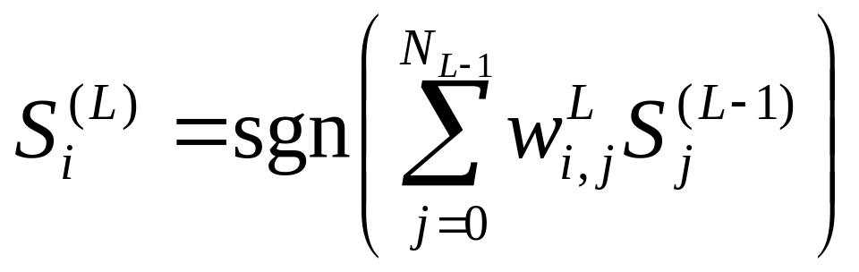
Basic notions and notation
We consider layered nets, made of binary units which can be in a plus or minus state.
A unit i in the Lth layer is connected to the N_{L-1} units and has state

Slide 7
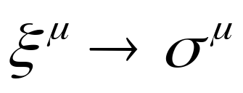
Basic notions and notation
For a given set of p₀ (distinct) pattern of N₀ binary units, we want to learn a given mapping
(1 -1 1 1 -1 → -1)

Slide 8
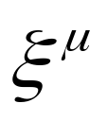
Theorem for convergence
To each input pattern (1 -1 1 1 -1 ) there corresponds a set of values of the neurons in the Lth layer as the internal representation of pattern in the layer L.

Slide 9
Theorem for convergence
We say that two patterns belong to the same class (for the layer L) if they have the same internal representation, which we call the prototype of the class.
The problem becomes to map these prototypes onto the desired output.

Slide 10
Theorem for convergence
master unit
  the first unit in each layer
ancillary unit
  all the other units in each layer, use to fulfil the faithfulness condition.
faithful
  two input patterns having different output should have different internal representations.

Slide 11
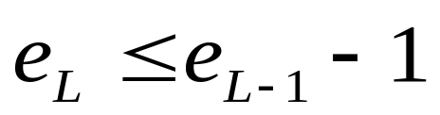
Theorem for convergence
Theorem:
  Suppose that all the classes in layer L-1 are faithful, and that the number of errors of the master unit, e_{L-1}, is non-zero. Then there exists at least one set of weights w connecting the L-1 layer to the master unit such that . Furthermore, one can construct explicitly one such set of weights u.

Slide 12
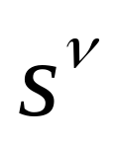

Theorem for convergence
Proof:
  Let be the prototypes in layer L-1. be the desired output(1 or –1).
  If the master unit of the Lth layer is connected to the L-1th layer with the weight w(w₁ = 1, w_{j} = 0 for j ~= 1), then e_{L}=e_{L-1}.

Slide 13
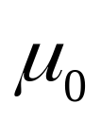
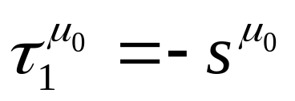
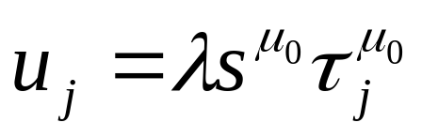
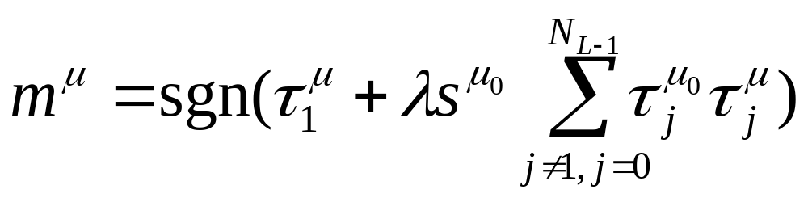
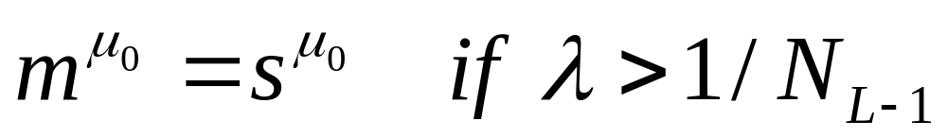
Theorem for convergence
  Let be one of the patterns for which , and let u be u₁=1 and
  then
  then

Slide 14
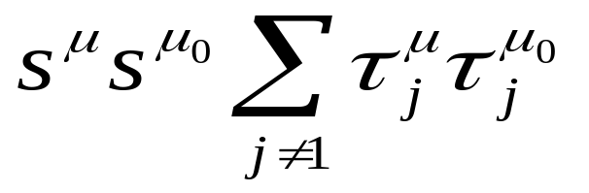
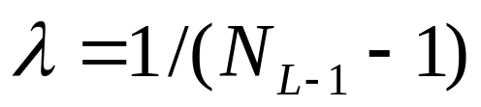
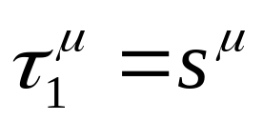
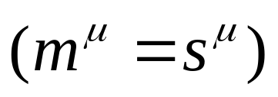
Theorem for convergence
  Consider other patterns,
  can be -N_{L-1}, -N_{L-1}+2, …, N_{L-1}
  Because the representations in the L-1 layer are faithful, -N_{L-1} can never be obtained.
  Thus one can choose
  so the patterns for which
  still remain .

Slide 15
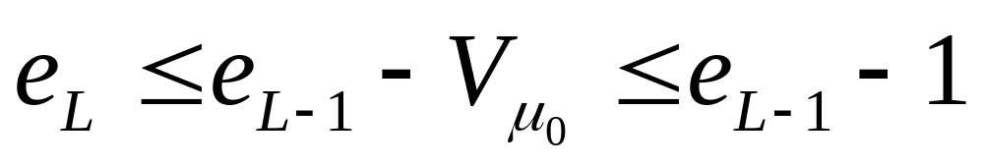
Theorem for convergence
  Hence u is one particular solution which, if used to define the master unit of layer L, will give

Slide 16
Generation the master unit
Using ‘pocket algorithm’
If the particular set u of the previous section is taken as initial set in the pocket algorithm, the output set w will always satisfy .

Slide 17
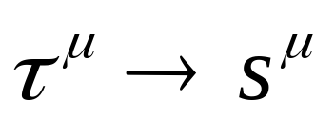
Building the ancillary units
The master unit is not equal to the desired output unit means that at least one of the two classes is unfaithful.
We pick one unfaithful class and add a new unit to learn the mapping
for the patterns μ belonging to this class only.
Repeat above process until all classes are faithful.

Slide 18
Simulations
Exhaustive learning (use the full set of the 2^{N} patterns)
  Parity task
  Random Boolean function
Generalization
Quality of convergence
Comments

Slide 19
Parity task
In the parity task for N₀ Boolean units the output should be 1 of the number of units in state +1 is even, and –1 otherwise.

Slide 20
Parity task
Hidden layer
Unit number | Threshold | Coupling from the input layer to the hidden unit i
1 | -55 | +11 | +11 | +11 | -11 | +11 | -11
2 | +33 | -11 | -11 | -11 | +11 | -11 | +11
3 | -11 | +11 | +11 | +11 | -11 | +11 | -11
4 | -11 | -11 | -11 | -11 | +11 | -11 | +11
5 | +33 | +11 | +11 | +11 | -11 | +11 | -11
6 | -55 | -11 | -11 | -11 | +11 | -11 | +11

Slide 21
Parity task
Output unit
Threshold | Couplings from the hidden layer to the output unit
+11 | +11 | +13 | +13 | +13 | +13 | +11

Slide 22
Random Boolean function
A random Boolean function is obtained by drawing at random the output (±1 with equal probability) for each input configuration.
The numbers of layers and of hidden units increase rapidly with N₀.

Slide 23
Generalization
The number of training patterns is smaller than 2^{N}.
The N₀ input neurons are organized in a one-dimensional chain, and the problem is to find out whether the number of domain walls is greater or smaller than three.

Slide 24
Generalization
domain wall
  The presence of two neighboring neurons pointing in opposite directions
When the average of domain walls are three in training patterns, the problem is harder than other numbers.

Slide 25
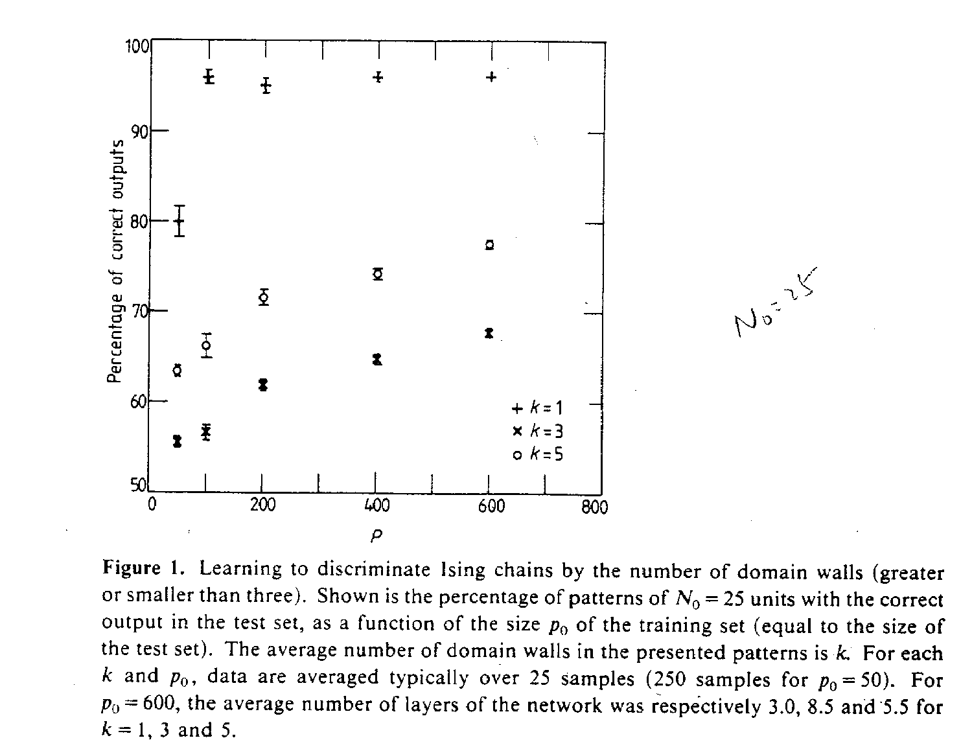

Slide 26
Quality of convergence
To quantify the quality of convergence one might think of at least two parameters.
  e_{L}
  p_{L} : the number of distinct internal representations in each layer L.

Slide 27
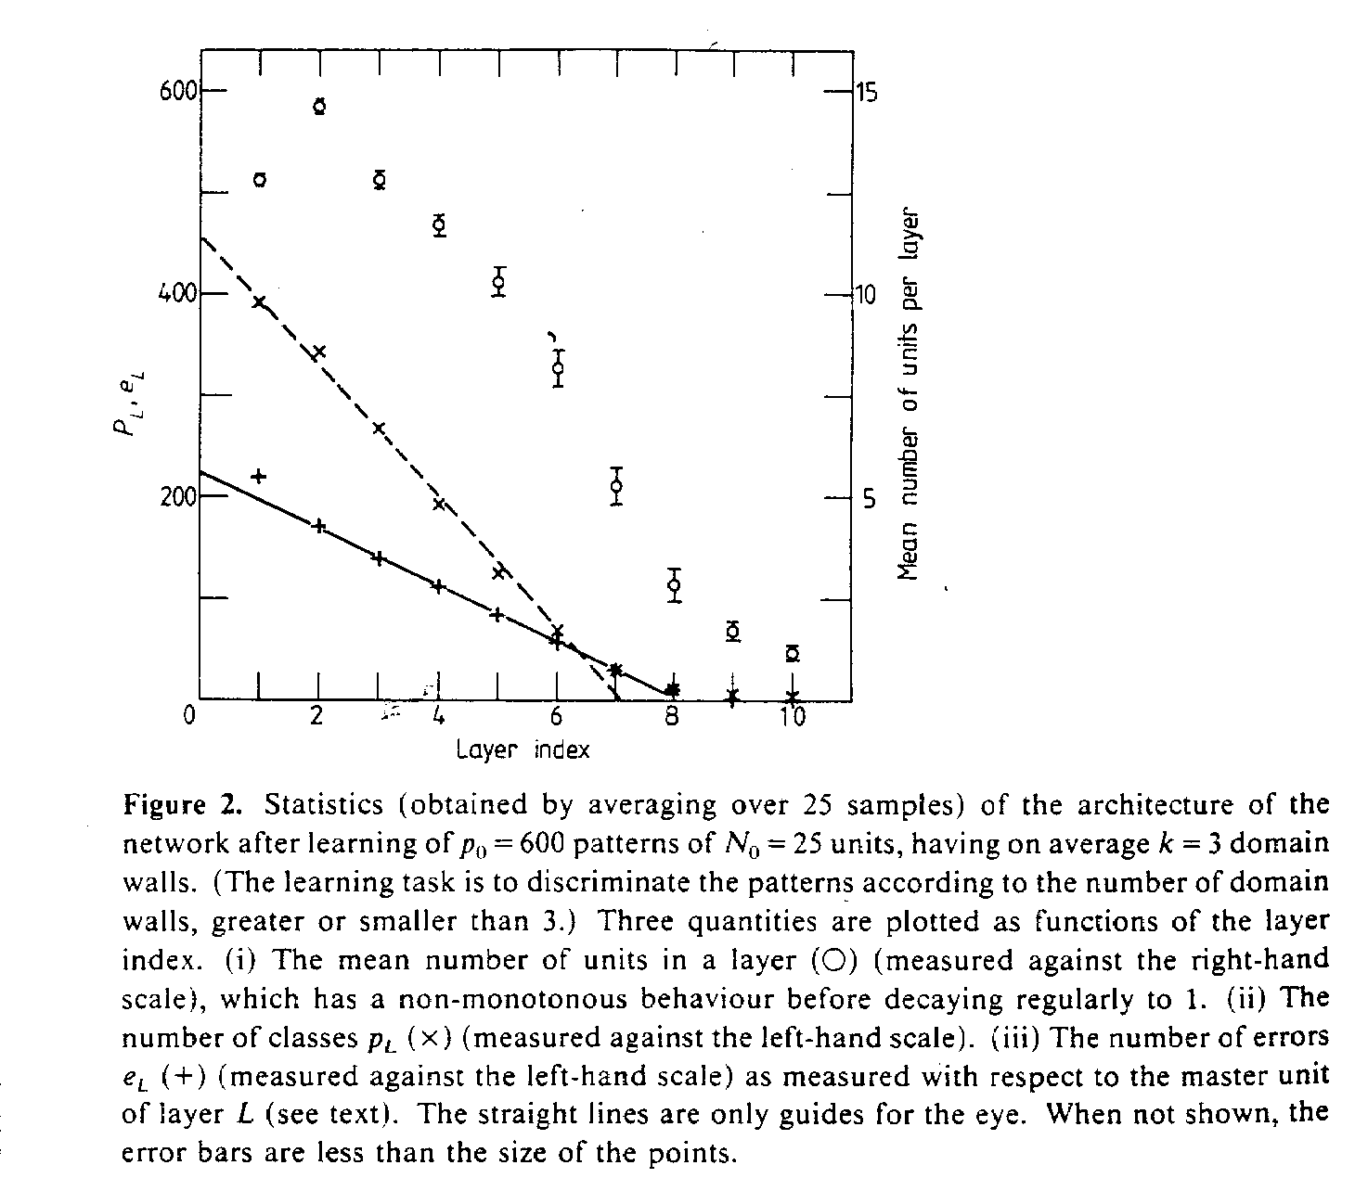

Slide 28
Comments
There is a lot of freedom in the choice of the unfaithful classes to be learnt.
How to choose the maximum number of iterations which are allowed before one decides hat the perceptron algorithm has not converged?

Slide 29
Concluding remarks
presented a new strategy for building a feedforward layered network
Identified some possible roles of the hidden units: the master units and the ancillary units
continuous inputs and binary outputs
conflicting data
more than one output units

